Slide 1
CANADA
Mgr. Janka Slobodníková
Gymnázium J. G. Tajovského
Banská Bystrica

Slide 2
Government and politics
Canada is a federal parliamentary democracy and a constituonal monarchy, with Queen Elizabet II as its head of state.
Canada is a member of the Commonwealth of Nations.
The country is officially billingual at the federal level.
It is one of the world's most ethnically diverse and multicultural nations, the product of large-scale immigration from many countries, with a population of approximately 35 million as of December 2012.

Slide 3
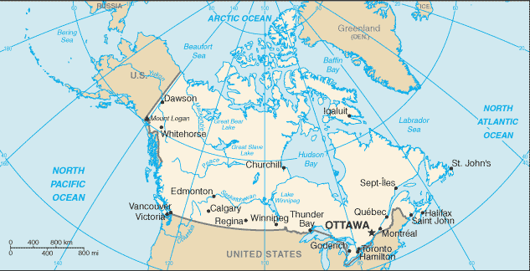
CANADA
Complete the text and choose the correct numbers:
CANADA is a country in North America.
It extends from the .................. Ocean to the ................... Ocean and northward into the .................... Ocean.
At 9.98 million square km in total consisting of .......................... provinces and .......................... territories.
Pacific
Atlantic
Arctic
8
9
10
2
3
4
Key

Slide 4
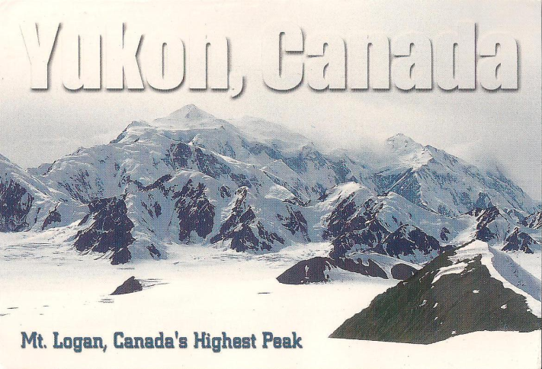
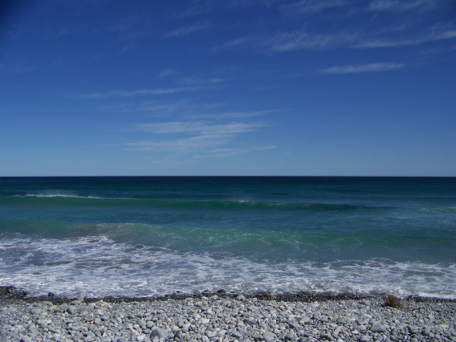


GEOGRAPHY
ELEVATION EXTREMES
The lowest point:
The Atlantic Ocean 0 m
The highest point:
Mount Logan 5,959 m
CLIMATE
- varies from temperate in south to subarctic and arctic in north
AREA
total: 9,984,670 sq km
- slightly larger than the US

Slide 5
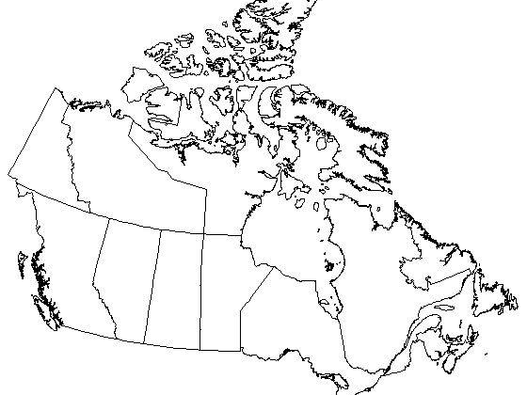
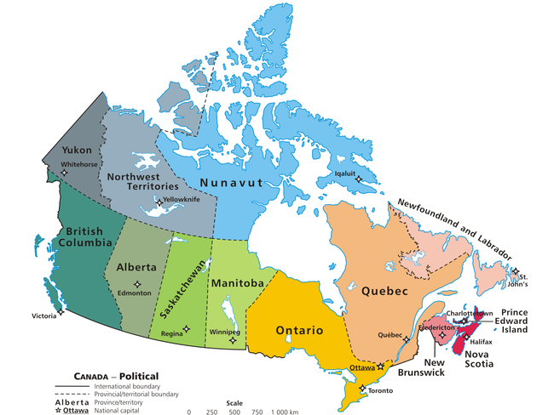
CANADIAN PROVINCES AND TERRITORIES
Key
Name provinces and territories (from the largest to the smallest ones):
1 – Nunavut, 2 - Quebec, 3 - Northwest Territories, 4 - Ontario,
5 - British Columbia, 6 – Alberta, 7 - Saskatchewan, 8 – Manitoba,
9 - Yukon, 10 - Newfoundland and Labrador, 11 - New Brunswick,
12 - Nova Scotia, 13 - Prince Edward Island

Slide 6
Which are 3 largest metropolitan areas in Canada?
1-st ...........................
2-nd ...........................
3-rd ............................

Slide 7
LARGEST METROPOLITAN AREAS BY POPULATION
(2011 CENSUS)
Complete the table
ORDER | NAME | PROVINCE | POPULATION
1 |  | Ontario | 5,583,064
2 |  | Quebec | 3,824, 221
3 |  | British Columbia | 2,313,328
4 | Ottawa-Gatineau | Ontario-Quebec | 1,236,324
5 | Calgary | Alberta | 1,214,839
6 | Edmonton | Alberta | 1,159,869
7 | Quebec | Quebec | 765,706
Toronto
Montreal
Vancouver
Key

Slide 8
Find a pair to each expression written in a red bubble.
A) a captain of the Br. Navy
N) the lake
1. Mackenzie
F) the city/
the island
2. Vancouver
K) the longest CA river
B) a Canadian geologist
G) „The Great Spirit“
3. Logan
C) the capital of Saskatchewan
L) the Queen
4. Victoria
M) a province
H) the highest CA mountain
5. Saskatoon
D) the capital of Br. Columbia
6. Ontario
I) a purple berry
E) an explorer
7. Manitoba
J) „beautiful water“

Slide 9
Answers
1. Mackenzie
E) an explorer
K) the longest CA river
2. Vancouver
A) a captain of the Br. Navy
F) the city/
the island
B) a Canadian geologist
H) the highest CA mountain
3. Logan
4. Victoria
L) the Queen
D) the capital of Br. Columbia
Key
5. Saskatoon
C) the capital of Saskatchewan
I) a purple berry
6. Ontario
J) „beautiful water“
N) the lake
7. Manitoba
G) „The Great Spirit“
M) a province

Slide 10
Geographical vocabulary
nadmorská výška
altitude
geografická šírka
latitude
geografická dĺžka
longitude
polostrov
peninsula
silná snehová búrka
blizzard
záliv/ zátoka
bay/ gulf
prieliv
strait
vánok
breeze
ústie
mouth
Key

Slide 11
The Structure of the Federal Government
Sovereign
- Queen Elizabeth ll
Represented by the Governor General
LEGISLATIVE BRANCH
Parlament
Senate
105 members appointed by the PM
House of Commons
301 members elected by voters
EXECUTIVE BRANCH
Prime Minister
- Stephen Harper
and Cabinet
JUDICIAL
BRANCH
Supreme Court

Slide 12

Top 10 things to do and see in Toronto
Listen to the video
and answer the questions:
10) What does the big breakfast at Frans
include?
9) What are the names of the most famous
historical theatres?
8) How long is the underground shopping area
in Toronto?
7) How large is Toronto Chinatown?
6) What is the ROM?
5) When is the ice-rink at Nathan Phillips
Square open?
4) Who likes visiting bars on College St. and
why?
3) Which is the biggest ice hockey team in
Toronto?
2) What is the name of the largest department
store in the world?
1) When was the CN Tower built?

Slide 13
Top 10 things to do and see in Toronto

Slide 14
Top 10 things to do and see in Toronto
10) 2 eggs, 2 sausages, 2 bacon, 2 pancakes and fries
9) Princess of Wales, Royal Alexandra Theatre
8) 27 km
7) The largest Chinatown in North America
6) The Royal Ontario Museum
5) From November to March, 24 hours
4) Students because of cheap food and drinks
3) Toronto Maple Leafs
2) The Eaton Centre
1) In 1976
Listen to the video and answer the questions:
10) What does the big breakfast at Frans
include?
9) What are the names of the most famous
historical theatres?
8) How long is the underground shopping area
in Toronto?
7) How large is Toronto Chinatown?
6) What is the ROM?
5) When is the ice-rink at Nathan Phillips
Square open?
4) Who likes visiting bars on College St. and
why?
3) Which is the biggest ice hockey team in
Toronto?
2) What is the name of the largest department
store in the world?
1) When was the CN Tower built?
Key

Slide 15
National Symbols of Canada
The National symbols of Canada represent all that the nation stands for, its people, places, traditions and cultures.
The various National symbols of Canada are:
  • The National flag
  • The Maple leaf
  • The National anthem
  • The National animal

Slide 16
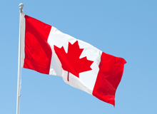
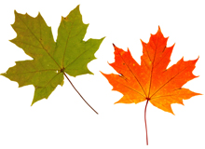
National Flag
Canada's official National flag is colored red and white, the country's official colors, and its center bears a maple leaf which is Canada's traditional emblem.
The Maple leaf
The history of the maple leaf as a symbol of Canada can be traced back as early as 1700. As Canada's National emblem, the maple leaf appears on the national flag and coins and for many years it was used as a symbol of the Canadian Armed Forces.

Slide 17

Oh Canada
Canadian national anthem
English lyrics

Slide 18
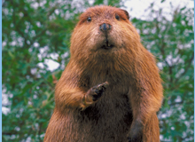
National animal
The Beaver is Canada's National animal and its discovery is associated with the discovery of the country itself. As an official National symbol, the beaver appears on several Canadian memorabilia like stamps and coins. The beaver is a symbol of ingenuity and perseverance. The beaver officially became the emblem in 1975.

Slide 19

Canadian Education System
-covers primary, secondary and post-secondary education.
-is governed by each provincional and territorial government.
All provincies and territories provide universal, free elementary and secondary schooling for 12 years except of Quebec (for 11 years).
Education is compulsory to the age of between 15 and 18, depending on the province.

Slide 20
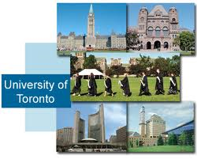
FIVE MAJOR CANADIAN UNIVERSITIES
University of Toronto
McGill University
University of Western Ontario
University of BC
Queen's University

Slide 21

Attractions in Vancouver
Which attractions would you find in Vancouver?

Slide 22
Sources
http://www.123independenceday.com/canada/national-symbols.html
http://en.wikipedia.org/wiki/Canada
http://www.youtube.com/watch?v=q7Zn6ERmZXM
http://www.youtube.com/watch?v=Hq1uio9a0cU
http://www.schoolsincanada.com/Canadian-Education-System.cfm

Slide 23

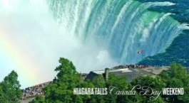
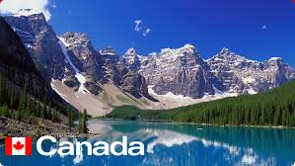
Thank you for your attention.

